Slide 1
Snow & Ice Preparedness Plan
Group 6 Data Engineering Team
Members:
Rakshitha Gaddam
Tharuni Rangineni
Visalakshi Polepalli
Vishnu Priya Palagiri

Slide 2
Overview
Use case: Assist city emergency teams in winter storm preparation
Integrates NOAA historical data + Open‑Meteo live forecast
Supports proactive decisions for road treatment and storm response

Slide 3
Generation
Static NOAA climatology dataset (long-term trends)
Streaming weather forecasts from Open‑Meteo API

Slide 4
Collection
NOAA data pulled from Google Cloud Marketplace
Open‑Meteo data received through periodic API calls
Both stored initially in Cloud Storage buckets

Slide 5
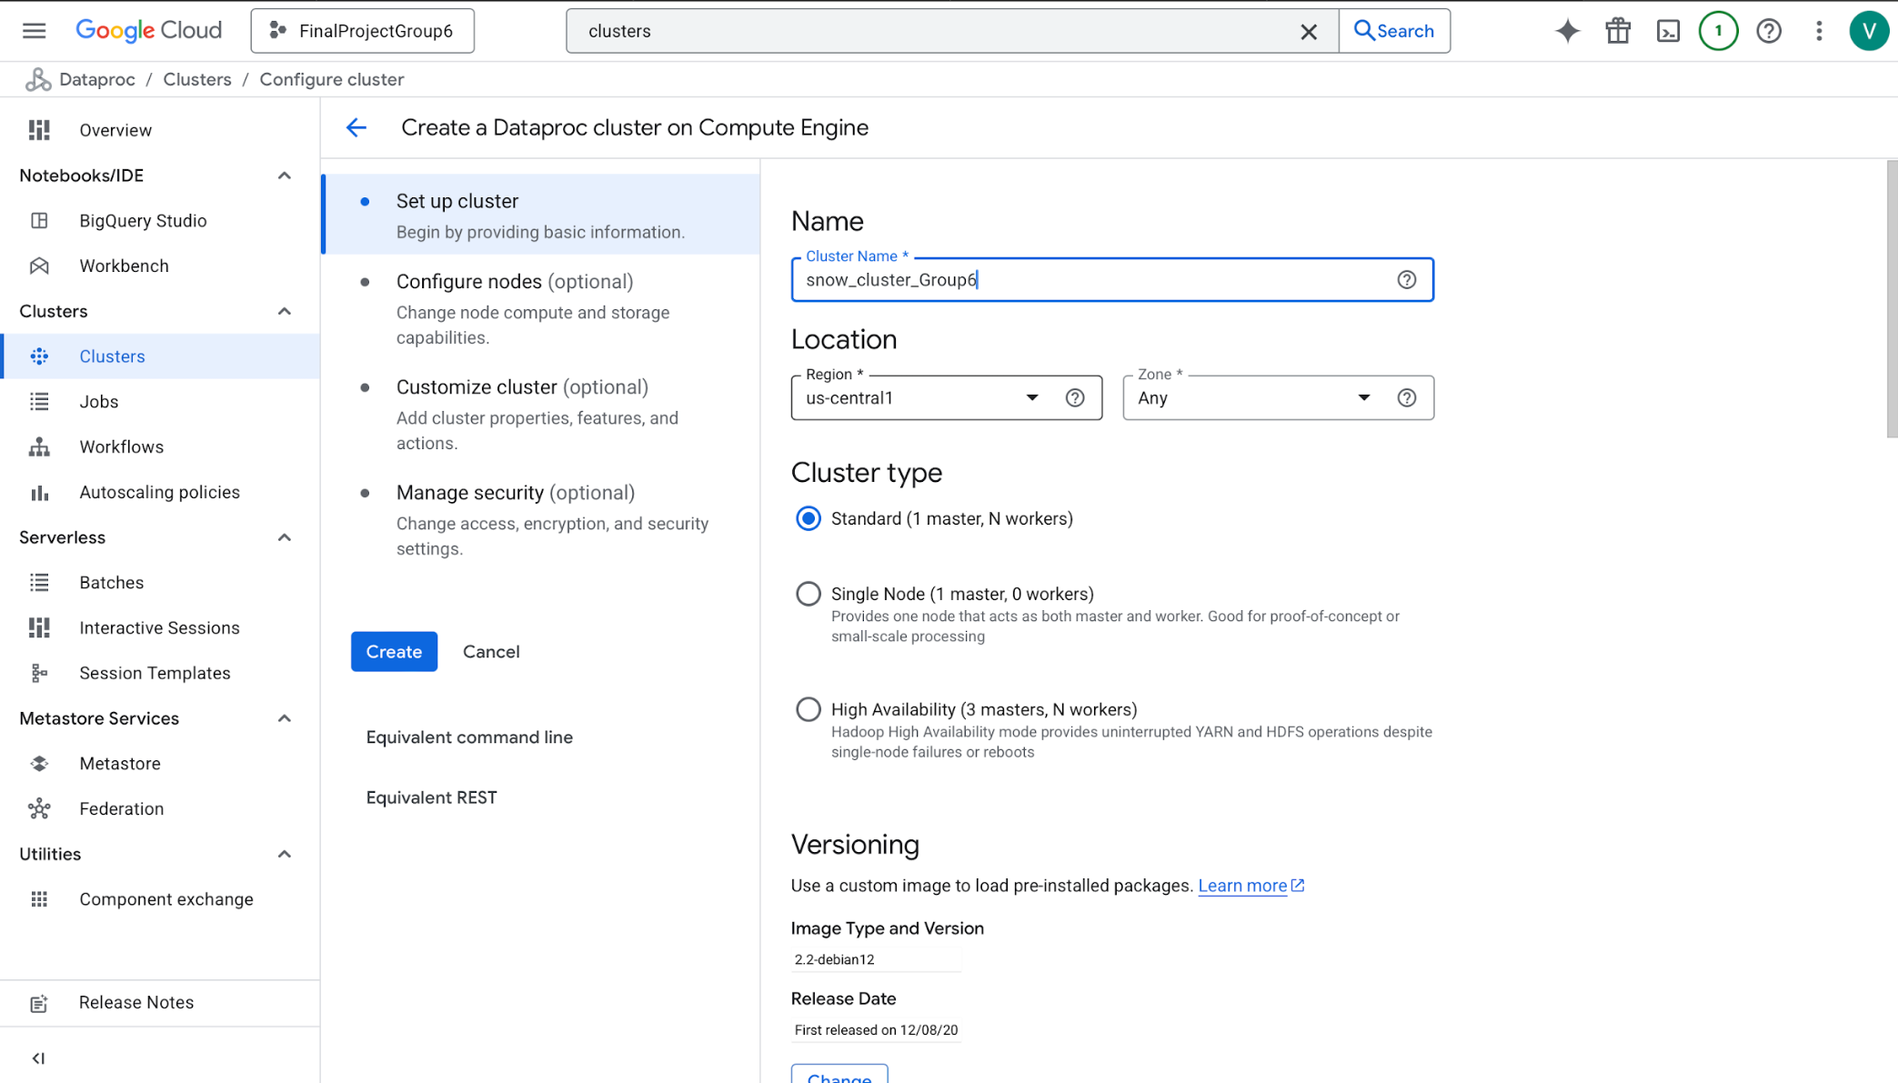
Processing
Dataproc cluster used for data loading and analysis
Cleaning data and storing in the clusters
Hive tables built for structured querying

Slide 6
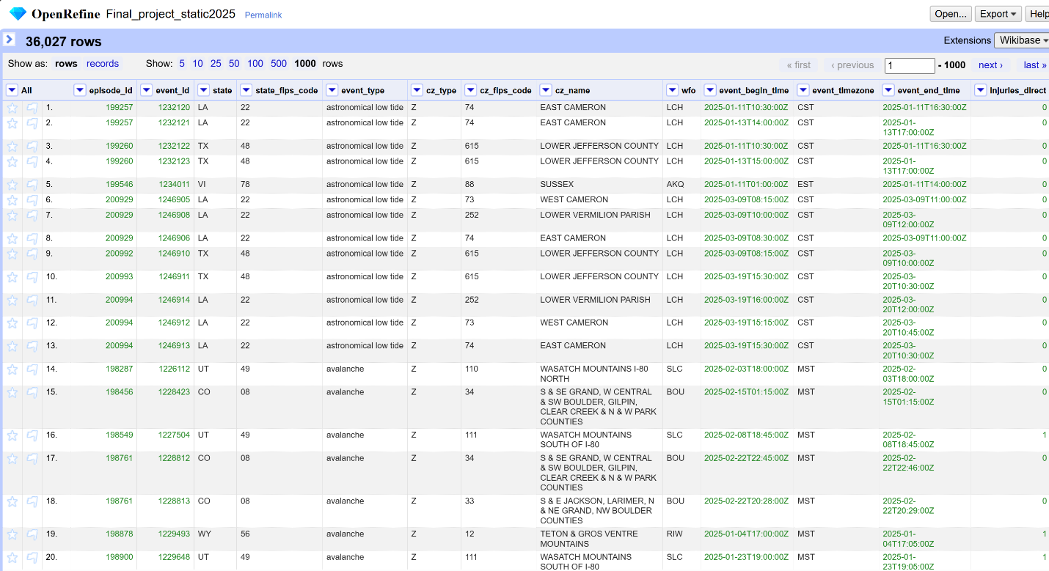

Slide 7
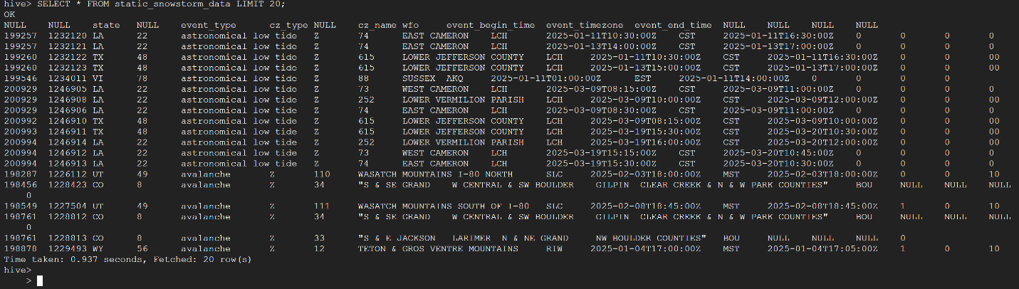

Slide 8
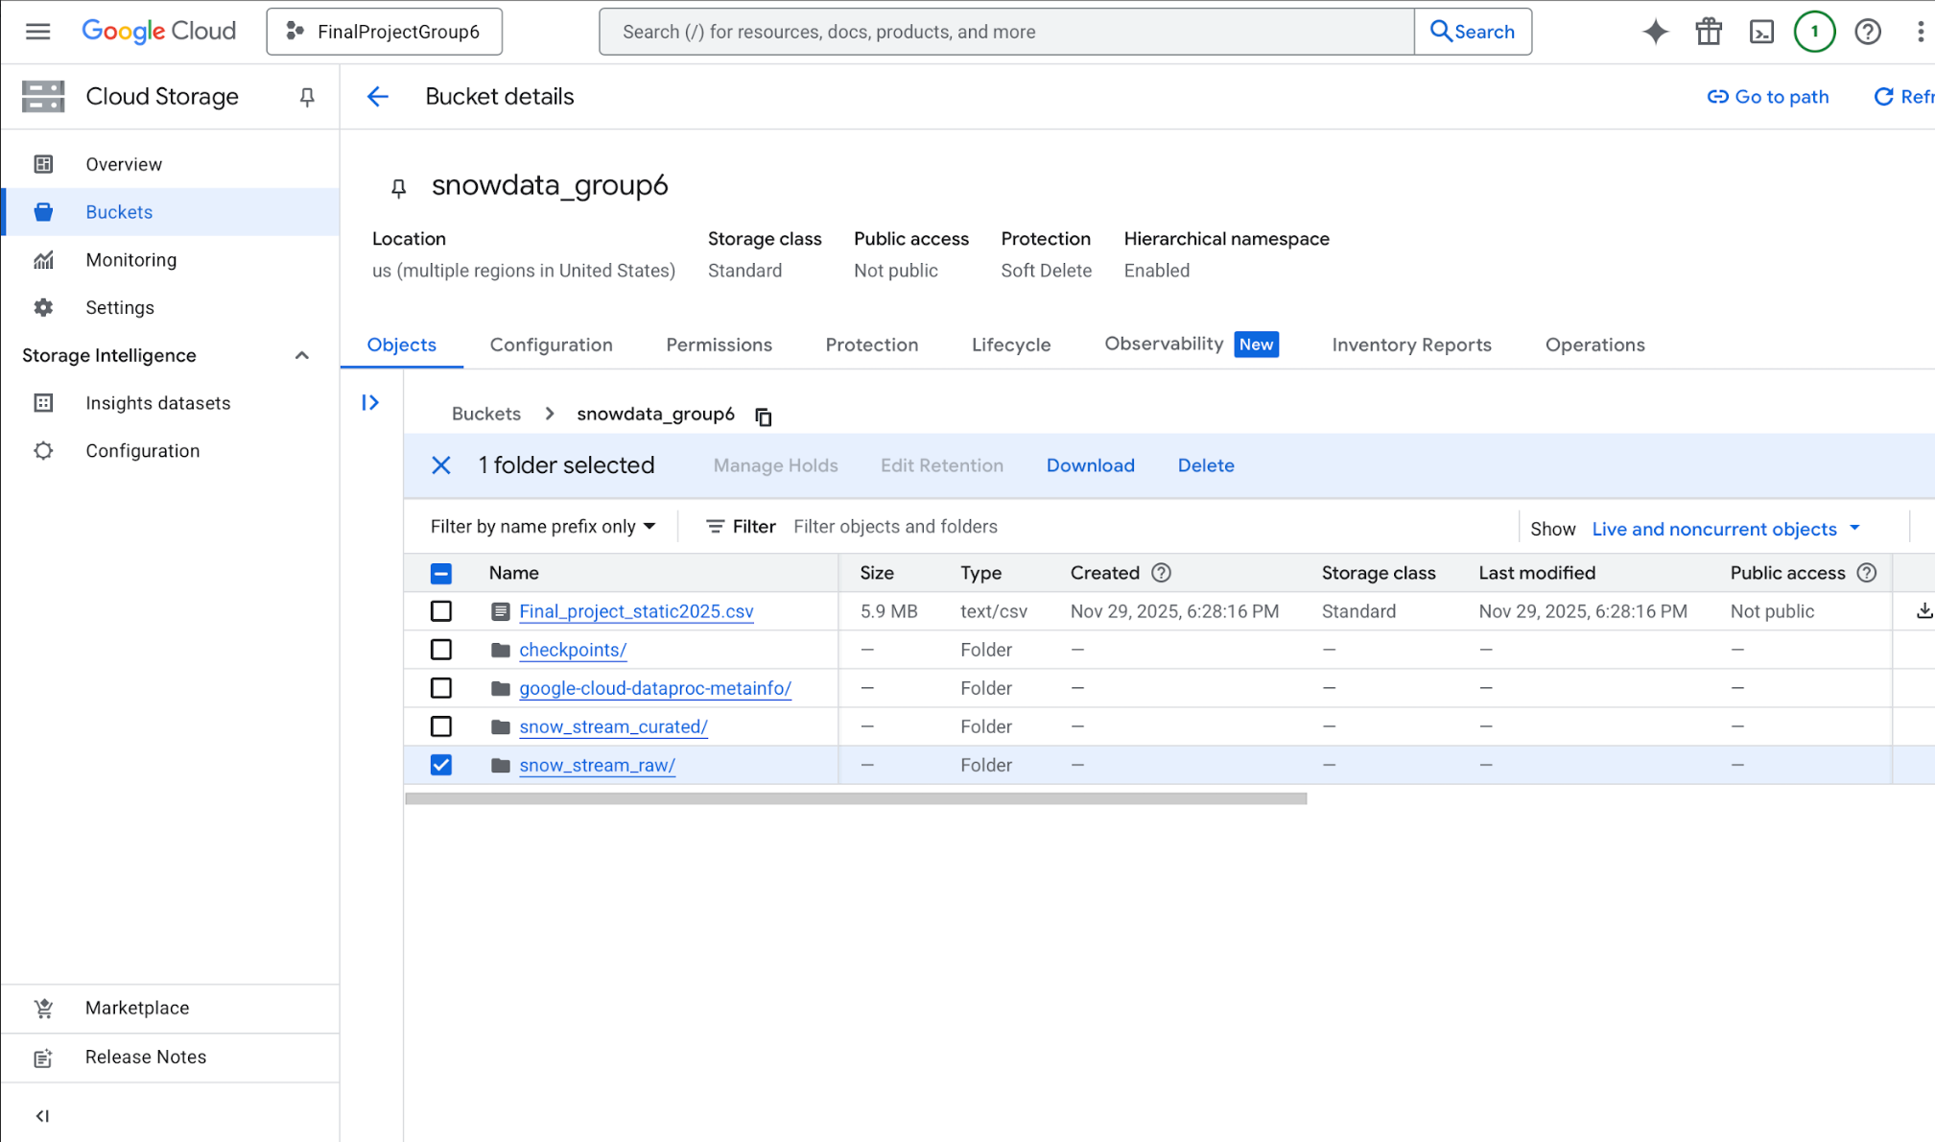
Storage
Cloud Storage buckets maintain raw, processed, and curated data zones
Static and streaming data organized for scalability

Slide 9
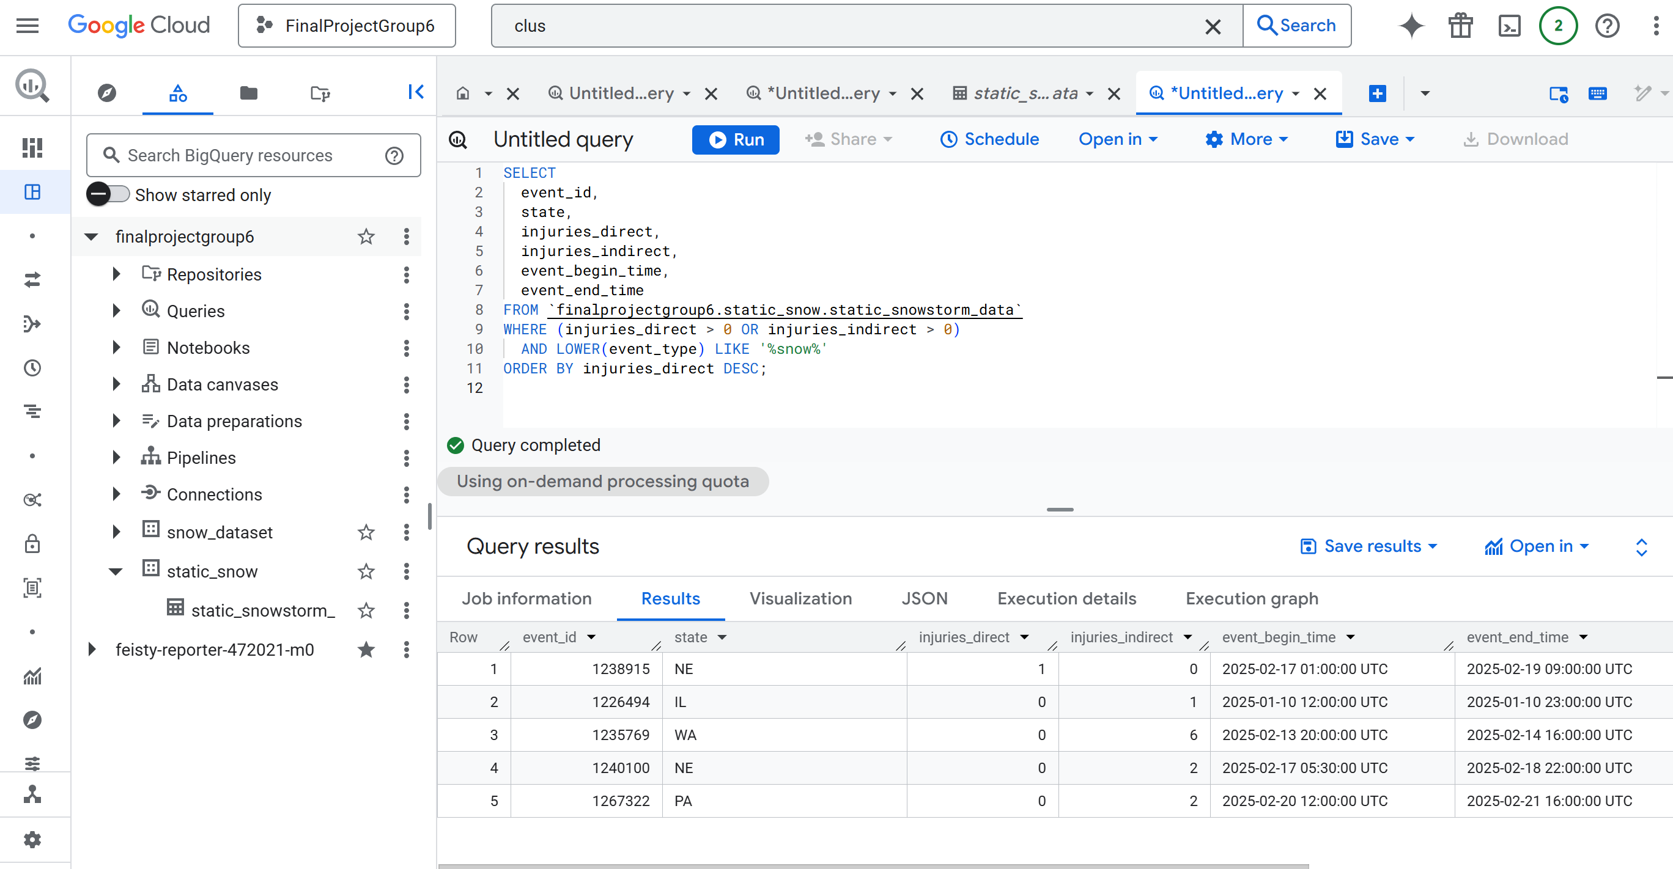
Management
BigQuery used for data quality checks and validation
Ensures accurate, analysis-ready datasets for downstream teams

Slide 10
Management
Streaming data is automatically extracted and loaded into the Dataproc cluster.
Spark processes the incoming API data and standardizes the schema.
Hive organizes the streamed data for easy querying and validation

Slide 11
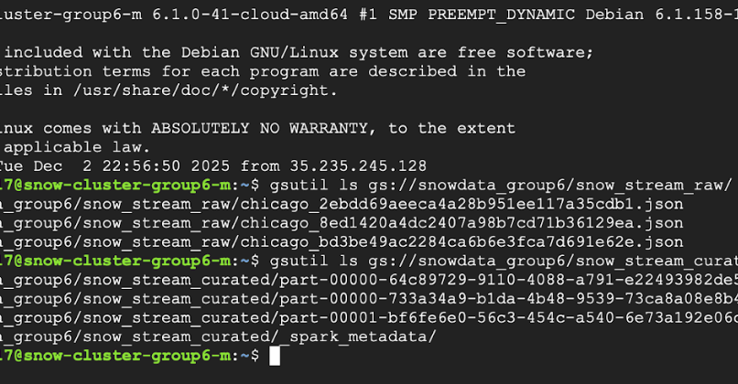

Slide 12
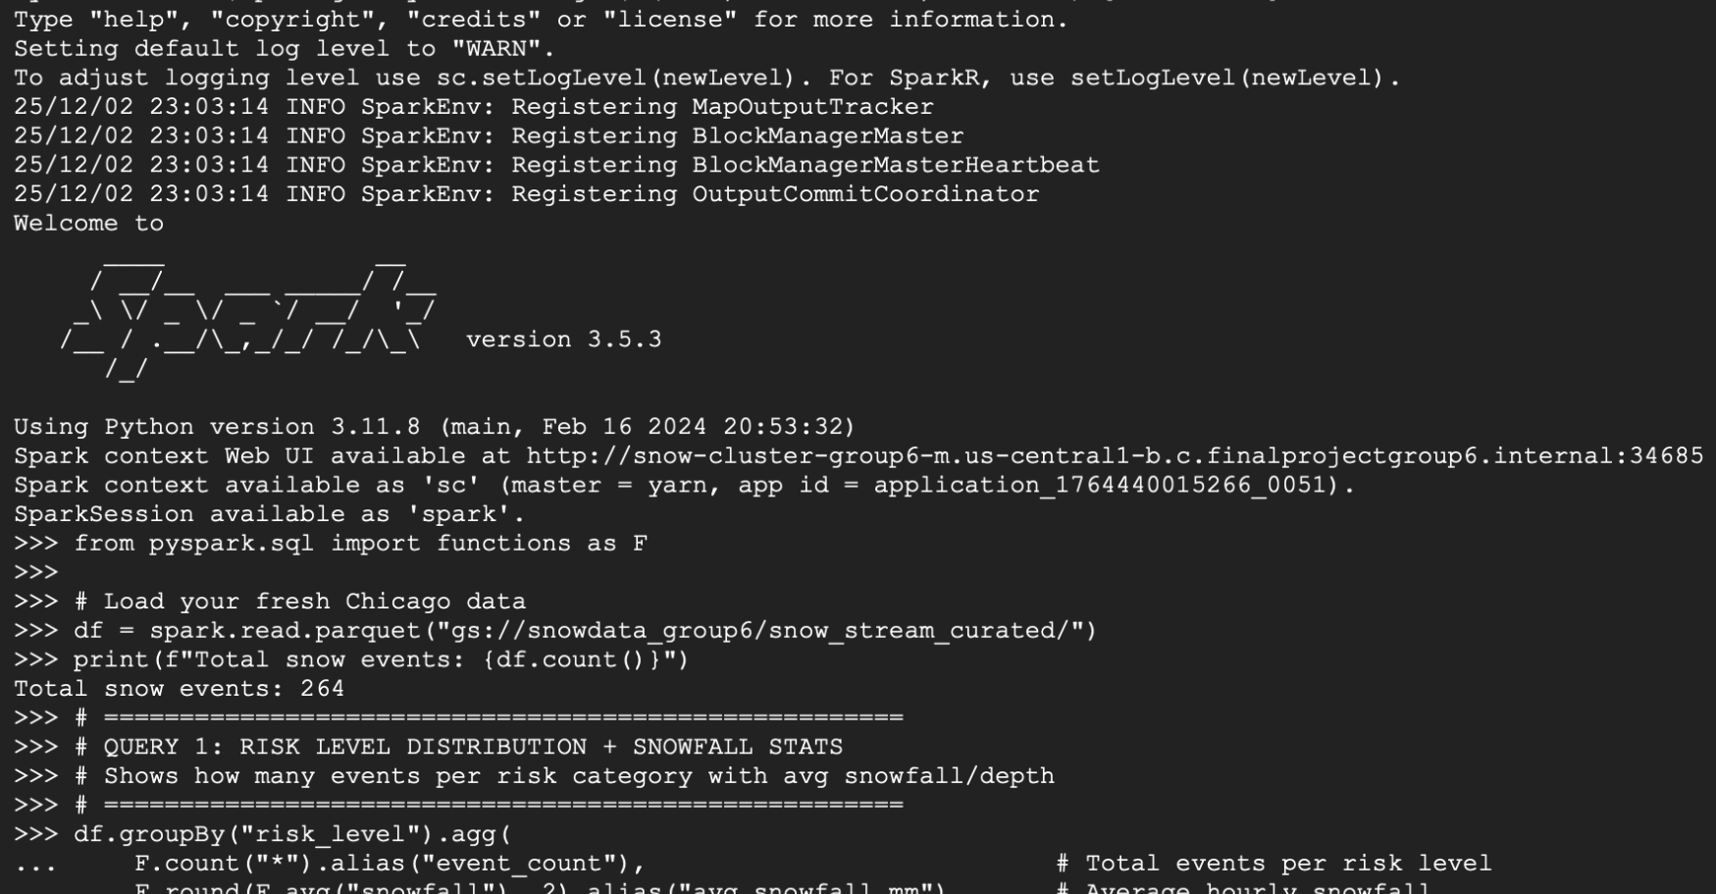

Slide 13
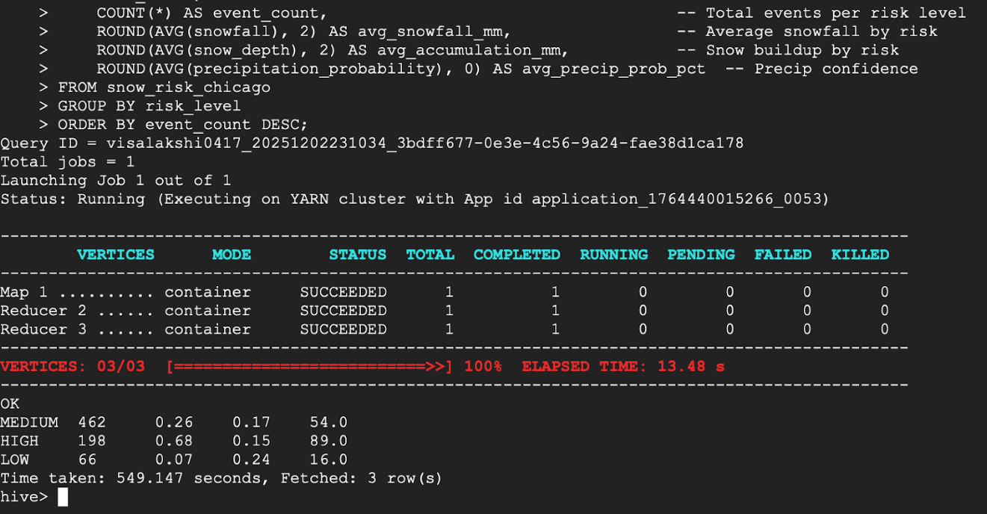

Slide 14
Analysis
Historical patterns and with real-time data
Risk scoring models for icing and storm severity

Slide 15
Analysis
Snowfall and snow depth
Temperature trends
Precipitation probability
Wind speed and gusts

Slide 16
Visualization
Planned dashboards for storm activity, road conditions, snow accumulation
Provides fast decision support for emergency operations

Slide 17
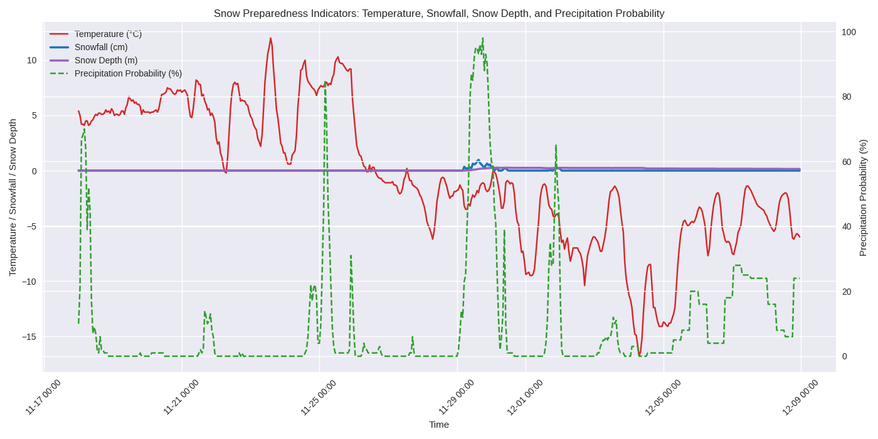

Slide 18
Visualization
This visualization provides a time-based view of storm progression, making it easier for emergency teams to anticipate hazardous periods and allocate resources effectively.

Slide 19
Interpretation & Snow preparedness plan
Monitoring and early warning
Road treatment and plowing
Resource staging
Community safety
Post-storm Recovery

Slide 20
References
NOAA National Centers for Environmental Information. (2024). Climate data records. U.S. Department of Commerce. https://www.ncei.noaa.gov/
Open-Meteo. (2024). Weather forecast API documentation. https://open-meteo.com/en/docs
Google Cloud. (2024). Dataproc documentation. https://cloud.google.com/dataproc/docs
Google Cloud. (2024). BigQuery documentation. https://cloud.google.com/bigquery/docs
Google Cloud. (2024). Cloud Storage documentation. https://cloud.google.com/storage/docs

Slide 21
Thank you

